Slide 1
Functional Programming
Introduction & Game of Life
Eric Finster
Martin Escardo
Mian M. Hamayun

Slide 2
Module Outline
Week 1
Introduction to Haskell - Conway's Game of Life.
Types in Haskell
Polymorphism
Week 2
Type classes and instances
Functions
More on type classes
Even more on type classes
Week 3
List comprehensions
Recursive functions
Higher-order functions

Slide 3
Module Outline (cont’d)
Week 4 & 5
User defined data types I
Lazy natural numbers
Week 6
Consolidation Week
Week 7
User defined data types II
Week 8 & 9
Monads
Week 10
Implementing a small imperative language
Week 11
Implementing a small imperative language
Rigorous programming
Additional, optional materials
A model IO' of the IO monad
Unbeatable tic-tac-toe
Elements of Laziness
Module Outline on Gitlab

Slide 4
Module Learning Outcomes
On successful completion of this module, students should be able to:
Present the basic ideas of functional programming languages
Demonstrate the main elements of good functional programming style
Illustrate some of the uses and applications of functional programming
Understand and apply more advanced features of typed functional programming.

Slide 5
Important General Information
All module files are kept on GitLab rather than on Canvas. This includes:
Lecture Notes
Weekly Activity Plans
Problem Sheets
Assessed Assignments (Class Tests)
and other relevant stuff including
Notes on Plagiarism
Link to Hoogle (for finding library functions)
Canvas page
Link to Teams Student Support

Slide 6
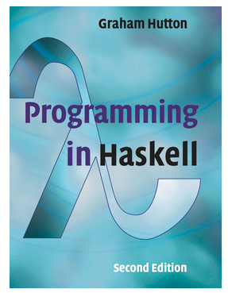
Module Textbook & Assessments
Officially adopted textbook:
Programming in Haskell
Graham Hutton
Cambridge University Press
Paperback: ISBN 978-1316626221; Kindle: ASIN B01JGMEA3U
318 pages, 120 exercises
Other free books include
Learn you a Haskell for Great Good
A Gentle Introduction to Haskell
Real World Haskell

Slide 7
Assessment Plan & Organization
Lectures / Labs (Edgbaston)
Lectures: Wednesdays, 9:00am-11:00am (UK)
Labs
Thursdays, 2pm-3pm & 3pm-4pm, UG04 Computer Science building
Fridays, 2pm-3pm & Fri 3pm-4pm, UG04 Computer Science building
Lectures / Labs (Dubai)
Lectures: Tuesdays, 11:00am-1:00pm (UAE)
Labs
Thursdays, 10am-12pm (UAE), 0411 – IT Cluster (Sec. A)
Thursdays, 1pm-3pm (UAE), 0411 – IT Cluster (Sec. B)
Assessments (more details given Here)
100% Continuous Assessments (2 Class Tests)

Slide 8
Motivational Example
In an imperative programming language, how can we compute the sum from 0 to a given number?
int total = 0;
for (int count = 1; count <= n; count++)
total = total + count;
How about Haskell?
> sum[1..n]
sum :: Num a => [a] -> a
sum [] = 0
sum (x:xs) = x + sum xs

Slide 9
The Zoo of Functional Programming Languages
Untyped Programming Languages
LISP 1958 (Lots of Insanely Stupid Parentheses - old joke :)
Untyped (rather only one type ie. S-expression)
Many languages in LISP family e.g. scheme, emacs lisp, …
Typed Programming Languages (infact strongly typed)
ML (Meta Language for theorem proving, developed at university of Edinburgh)
SML (1983), OCAML (1996), F# (2005, Microsoft)
Hope (1970), Miranda (1985), Haskell (1990)
Coq, Agda, Lean (dependently typed, concrete proofs)
write proofs of computer programs / correctness.

Slide 10
Other Languages with Functional Features
Java
lambda (anonymous functions)
functional interfaces
streams
Kotlin
The preferred language for Android development since 2019
More heavily based on functional programming ideas.

Slide 11
What is Functional Programming?
A function is a mapping that takes one or more arguments and produces a single result.
Functional programming is a style of programming, where the basic method of computation is the application of functions to arguments.
A functional programming language
allows storage of functions in data structures
constructing intermediate structures
taking functions as arguments
producing functions as results
functions defined in terms of themselves.

Slide 12
Learning Objective
To discuss a self-contained Haskell program that has many features that we will study in the next few
lectures.
Don't worry if you don't understand everything.
Our objective is to motivate the usefulness of these features with an entertaining example.

Slide 13
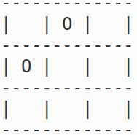
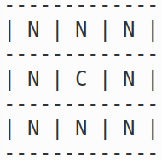
Conway’s Game of Life
The Game of Life, invented by John Conway, was an early example of a cellular automaton with complex behaviors generated from a simple set of rules.
The Game of Life begins by placing some tokens on the cells of a two-dimensional grid (infinite).
Cells of the grid that contain a token are said to be live, while empty cells are said to be dead.
Each cell has exactly eight neighbours, corresponding to the cells that are immediately adjacent horizontally, vertically, or diagonally.
The initial configuration is called the seed, or generation 0.

Slide 14
Conway’s Game of Life – Rules
The game is played deterministically according to the following rules of evolution whereby a cell interacts with its neighbours:
[Birth.] A dead cell with exactly three live neighbours becomes live at the next generation.
[Survival.] A live cell with either two or three live neighbours survives to the next generation.
[Death.] A cell dies from overcrowding if it has more than three live neighbours, or from isolation if it has fewer than two neighbours.
It is important to clarify that the rules specify that all of these births and deaths happen simultaneously as the grid evolves into the next generation, rather than in any particular order.

Slide 15
Conway’s Game of Life – Rules (Simplified)
The game proceeds in discrete steps of time and following the evolution function / rules given below:
Any live cell with 0 or 1 live neighbours dies by underpopulation.
Any live cell with 2 or 3 live neighbours survives.
Any live cell with more than 3 live neighbours dies by overpopulation.
Any dead cell with 3 live neighbours comes to life by reproduction.
Important: You have to apply these rules on the grid at the SAME TIME for each cell; If you apply these rules in any choosen order, its not going to work!

Slide 16
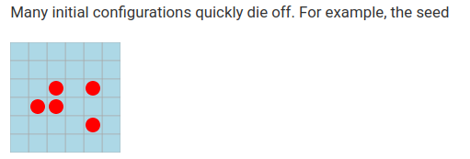
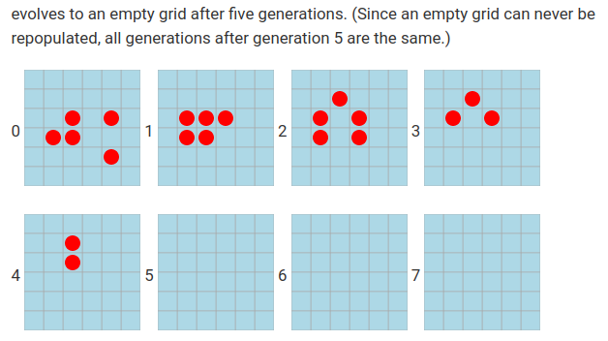
Conway’s Game of Life – Examples

Slide 17
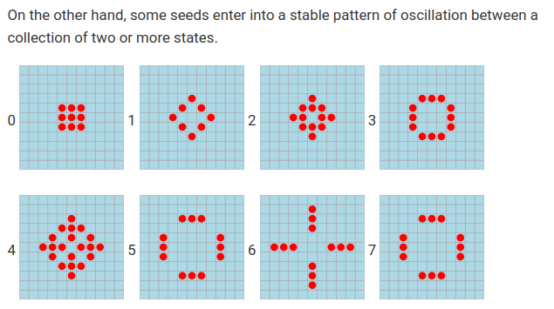
Conway’s Game of Life – Examples

Slide 18
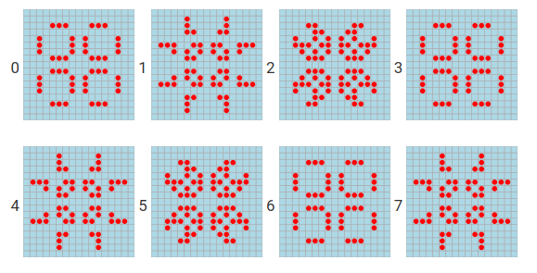
Conway’s Game of Life – Examples

Slide 19
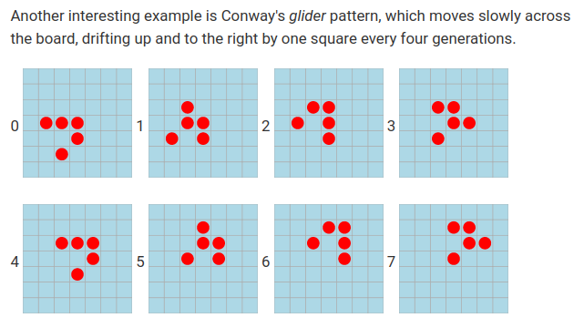
Conway’s Game of Life – Examples

Slide 20
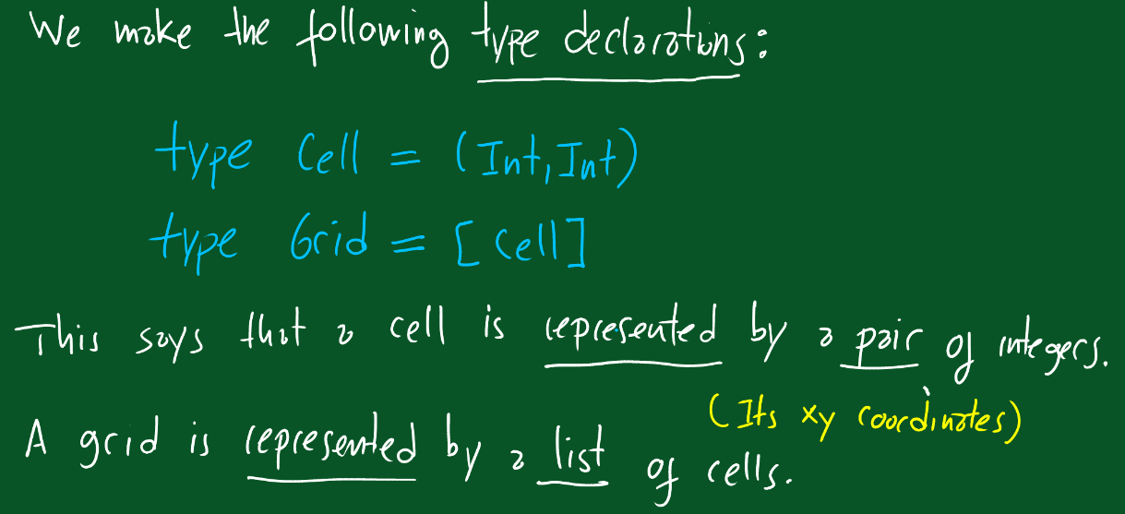
Game of Life – Implementation in Haskell

Slide 21
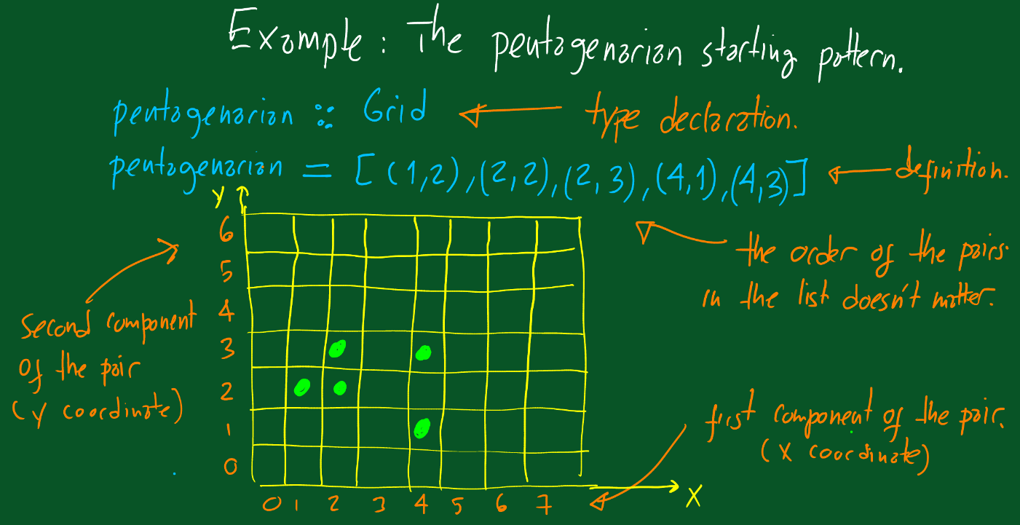
Game of Life – Implementation in Haskell (2)

Slide 22
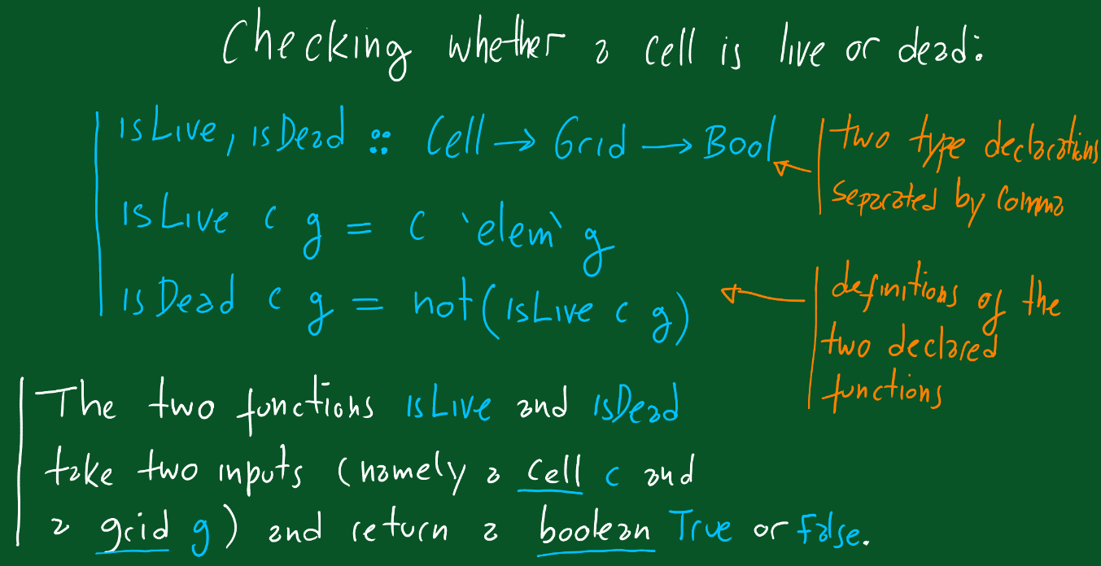
Game of Life – Implementation in Haskell (3)

Slide 23
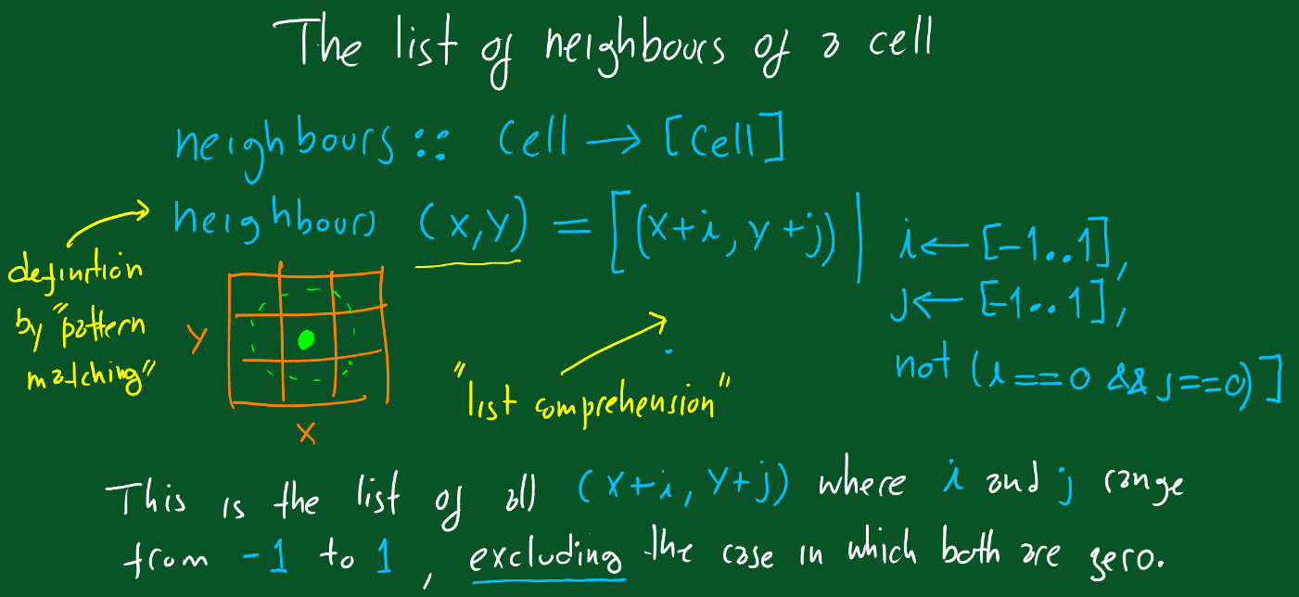
Game of Life – Implementation in Haskell (4)

Slide 24
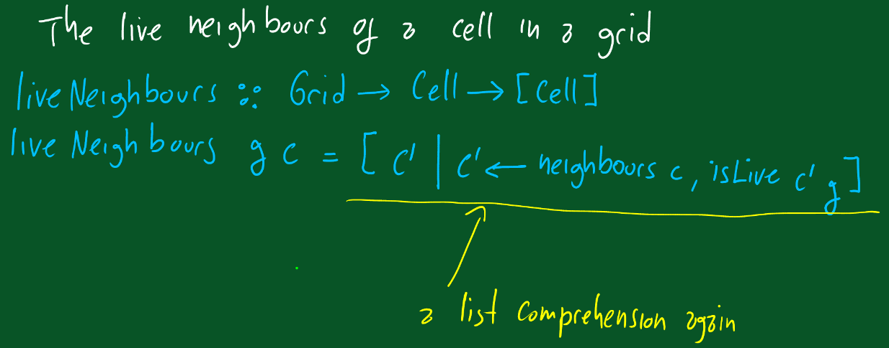
Game of Life – Implementation in Haskell (5)

Slide 25
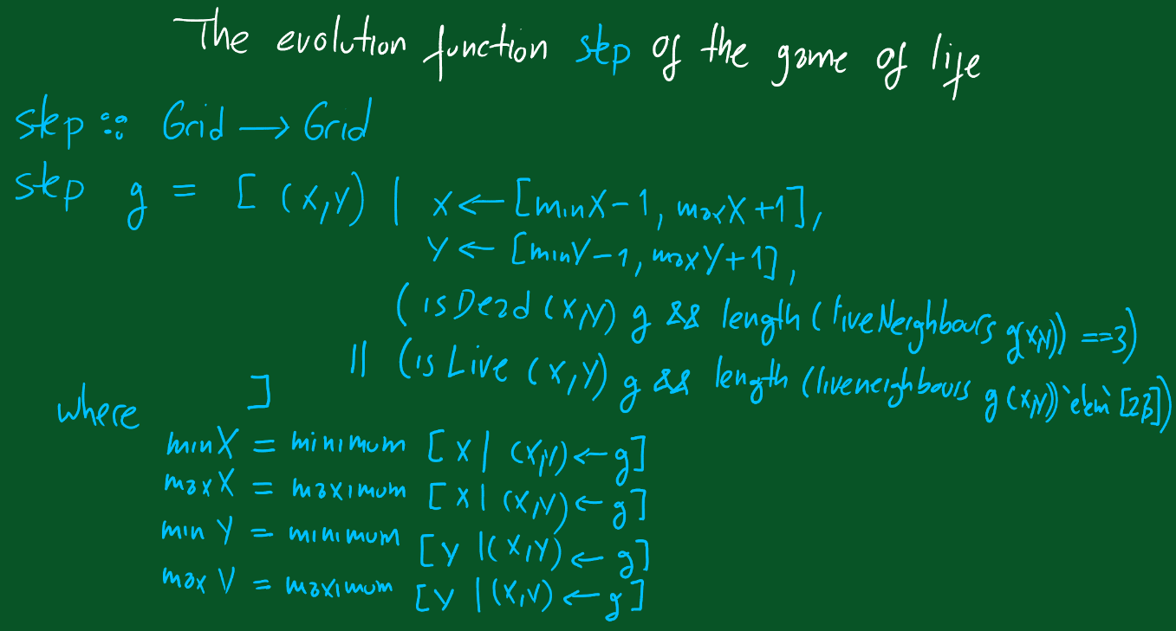
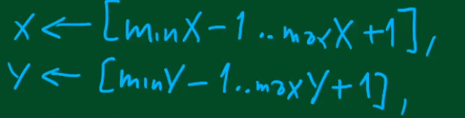
Game of Life – Implementation in Haskell (5)

Slide 26
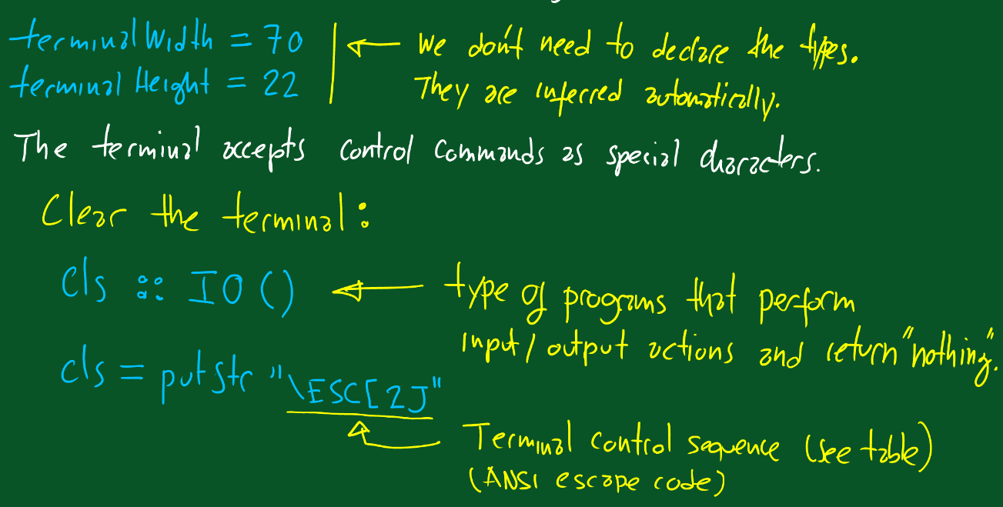
Game of Life – Implementation in Haskell (6)

Slide 27
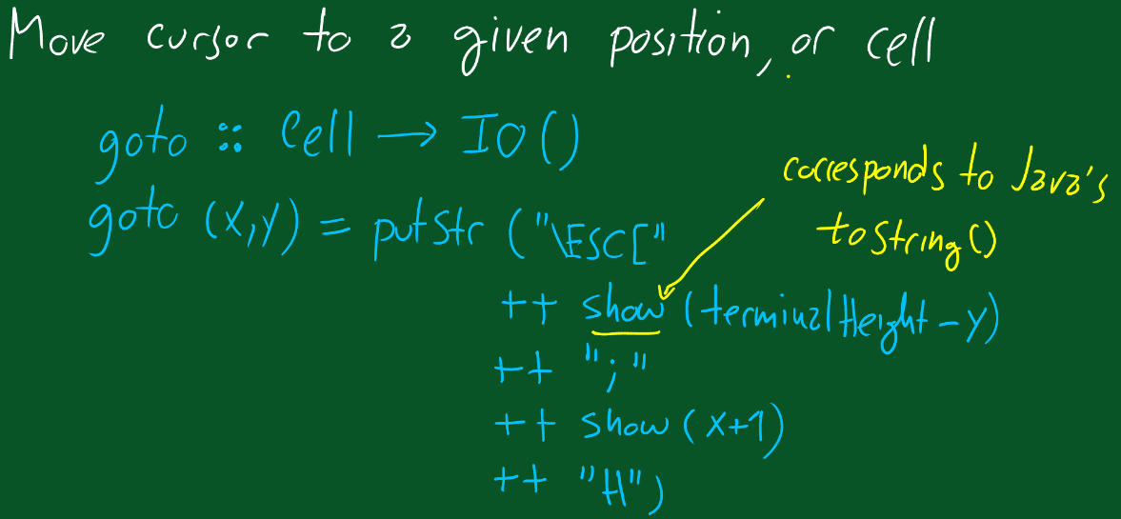
Game of Life – Implementation in Haskell (7)

Slide 28
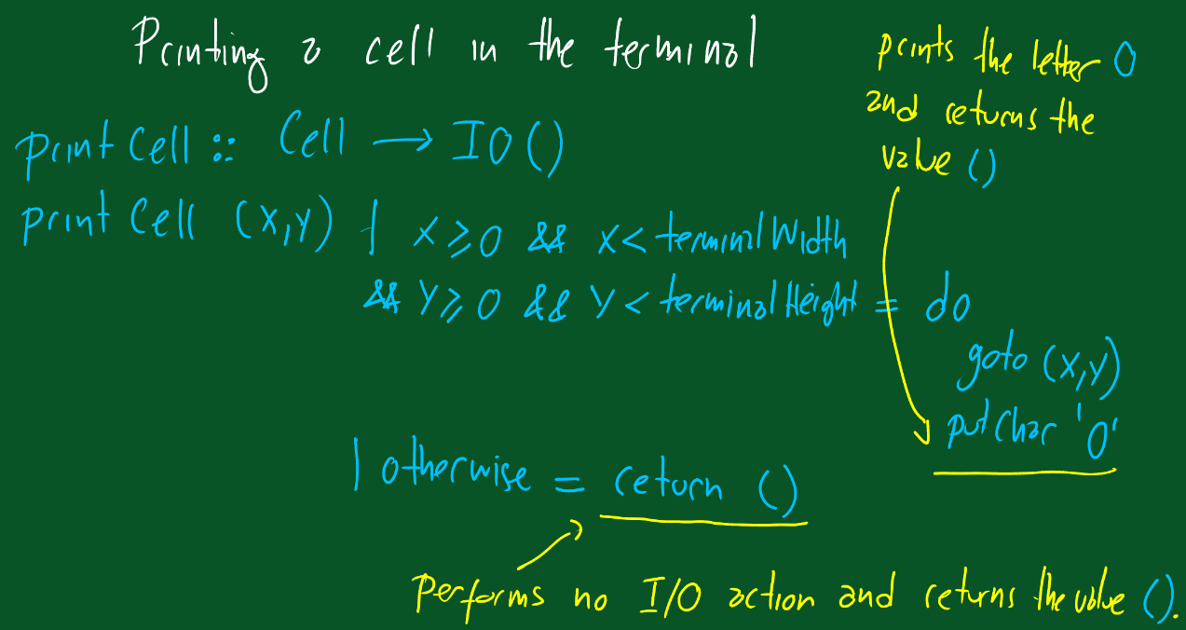
Game of Life – Implementation in Haskell (8)

Slide 29
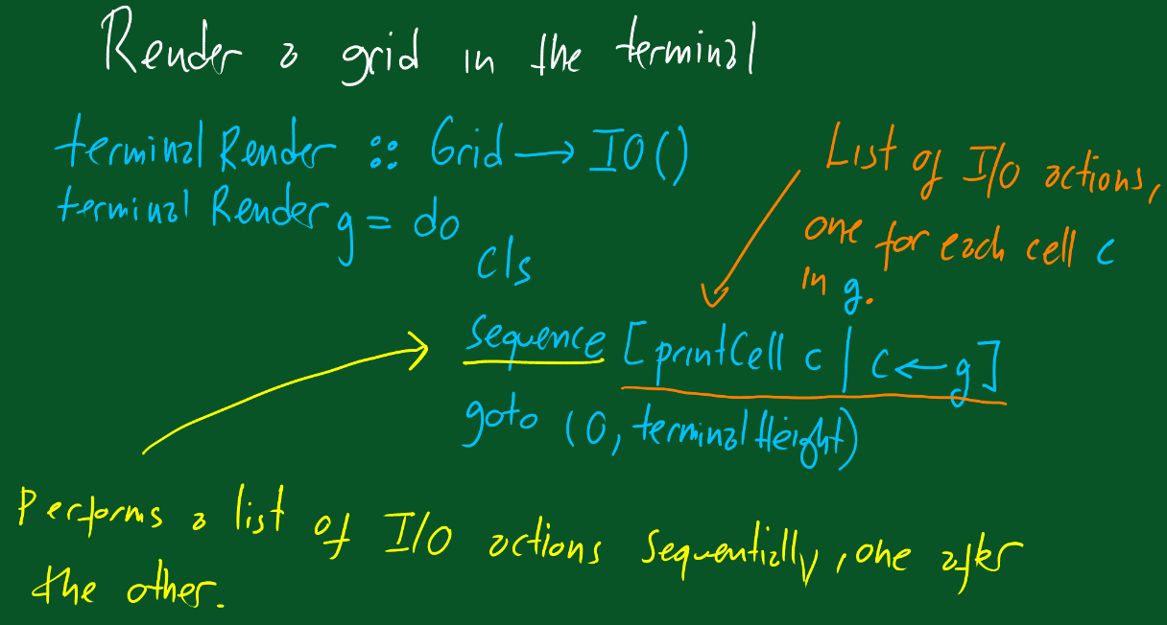
Game of Life – Implementation in Haskell (9)

Slide 30
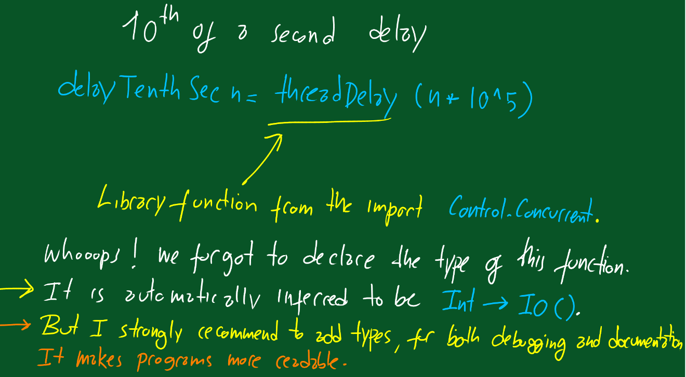
Game of Life – Implementation in Haskell (10)

Slide 31
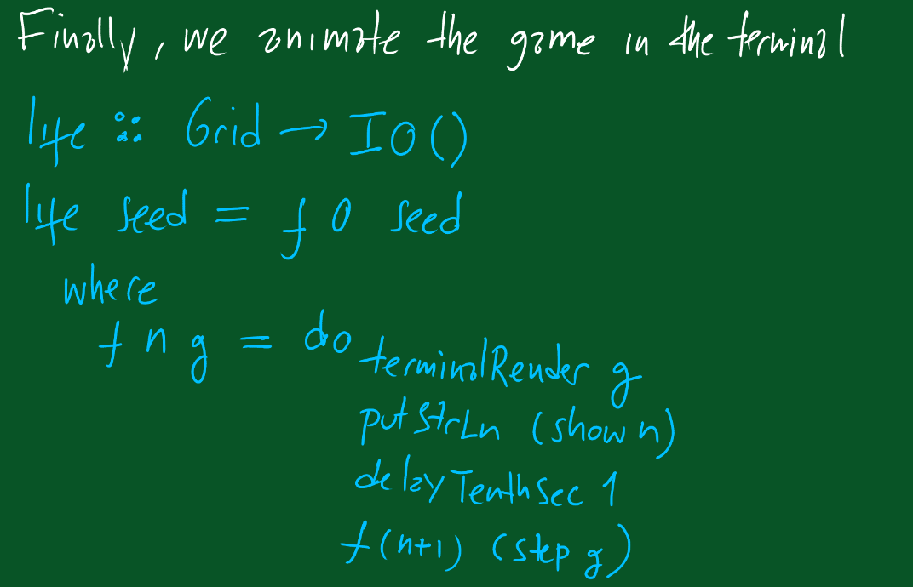
Game of Life – Implementation in Haskell (11)

Slide 32
Game of Life – Practice
Run Game of Life using runhaskell command or ghci, using interactive mode.
Try out different seed grids; increase decrease delay.
Compile using ghc (ghc --make Life.hs) and then try it out.
https://downloads.haskell.org/~ghc/latest/docs/html/users_guide/using.html
How to get the runable haskell code from lecture handouts.
cat Life.md | runhaskell ../../Resources/mdtohs.hs > Life2.hs

Slide 33
Summary
We have also developed a version in Kotlin for you.
Check the resources for the module for both the Haskell and the Kotlin files. Read the lecture notes too.
Can you translate them to Java, while maintaining their functional style?
We used the Game of Life to illustrate the features of Haskell that we’ll learn in the future lectures.

